Slide 1
Python Course GIS-introduction
Ronan Paugam, Eulàlia Planas

Slide 2
GIS - Geographic Information System

Slide 3

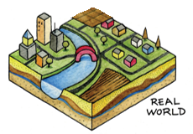
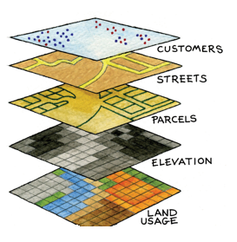
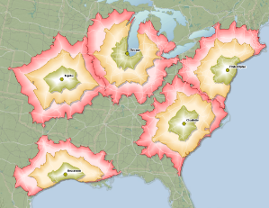
Geographic Information System - GIS
“A system for
capturing, storing, checking, integrating, manipulating, analyzing and displaying
spatial data”
GIS recreates real world spatial data
as digitized themed data “layers” (e.g. locations, boundaries, infrastructure, socioeconomic hydrology, land use/cover)
assembled in any combination
and overlaid for analysis
Image © source unknown. All rights reserved. This content is excluded from our Creative Commons license. For more information, see https://ocw.mit.edu/help/faq-fair-use/

Slide 4
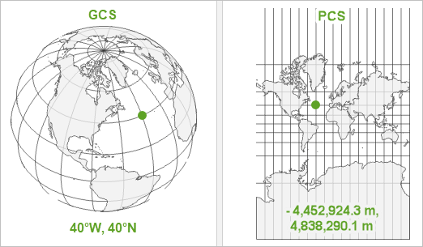
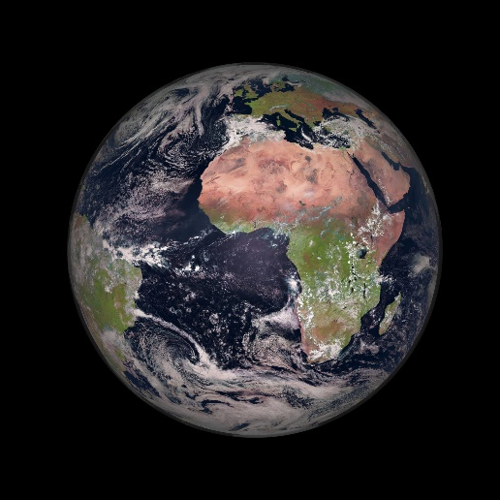
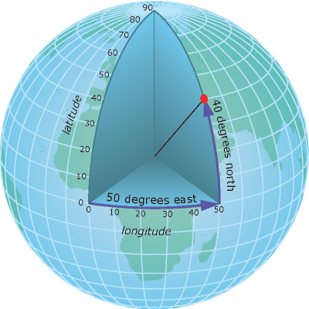
GIS: Coordinate System
Geographic Coordinate System (GCS)
angular unit of measure
prime meridian
datum based on a spheroid
Projected Coordinate Systems (PCS)
from the sphere to the map
GCS
PCS creates local distortion and affect area, angle and distance
WGS84 is the most widespread
The GCS tells your data where to draw. The PCS tells the map how to stretch the GCS out flat.
Which GCS you choose depends on where you are mapping.
Which PCS you use depends on where you are mapping, but also the nature of your map, for example, should you distort area to preserve angles, or vice versa?

Slide 5
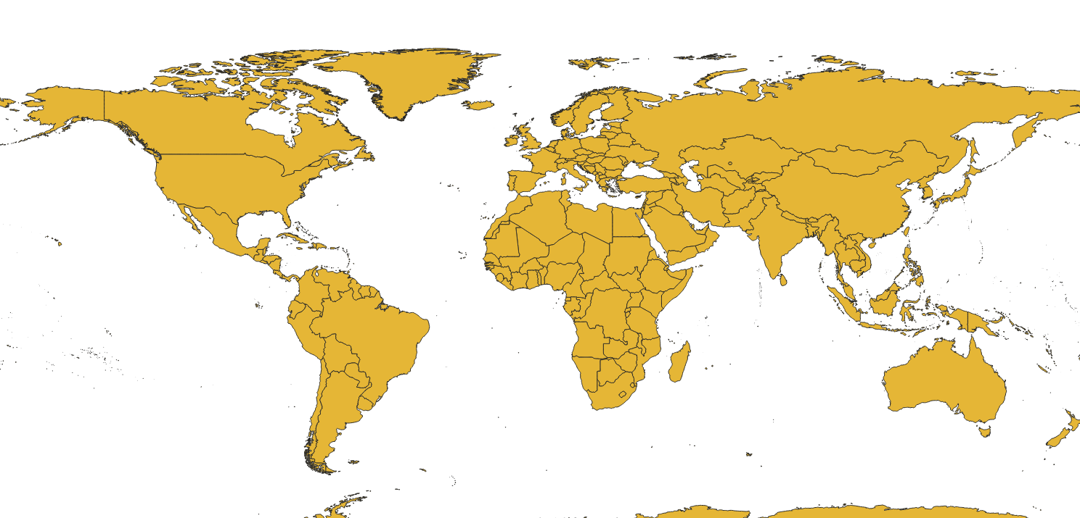
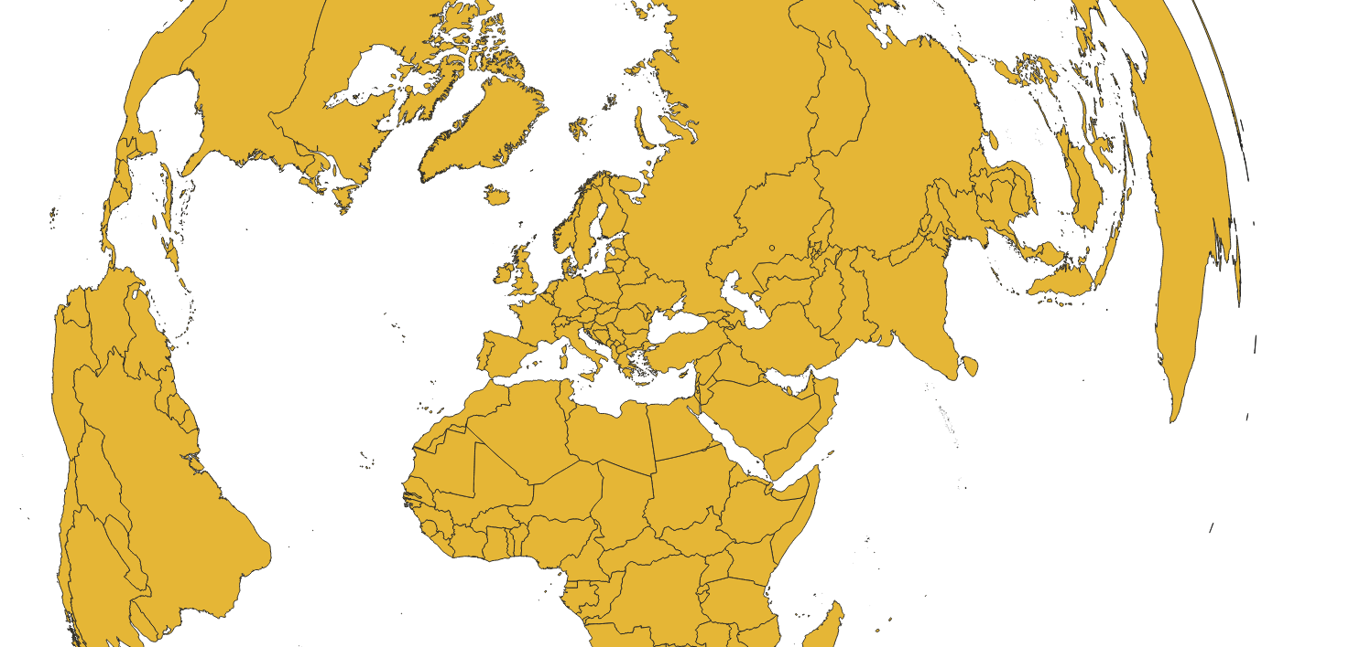
GIS: Coordinate Reference System CRS=GCS+PCS
EPSG:
public registry of geodetic datums, spatial reference systems, Earth ellipsoids, coordinate transformations and related units of measurement, originated by a member of the European Petroleum Survey Group (EPSG) in 1985
EPSG 4326: grid longitude = -180 to 180 and latitude = -90 to 90
Projection: Plate Carree
GCS = WGS84
used by the GPS system
EPSG 3035: conserve distance in Europe (<1m)
Projection: Lambert Azimuthal Equal Area
GCS = WGS84

Slide 6
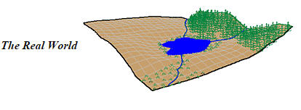
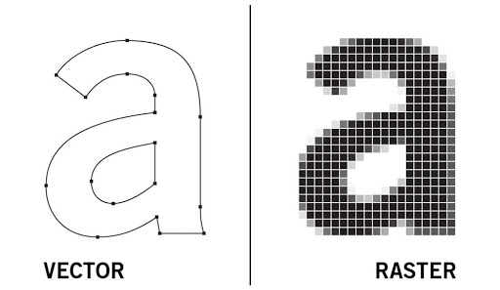
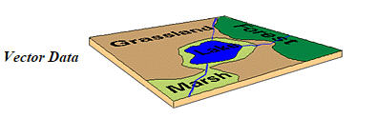
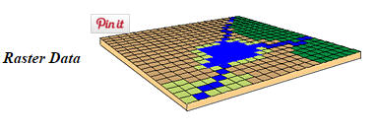
GIS: Data Representation
Information can be stored in vector or raster format.
Vectors are composed of coordinates
Raster's are composed of pixels
Geospatial or coordinate data can be represented in two different data formats:
Vector:
e.g. points, lines, and polygons
Fire Font can be stored as polygon
Raster:
e.g. row and column matrix
Fuel Class Map can be stored as raster
These are often used for variables with:
defined borders, e.g. manmade
continuous surface, e.g. environmental
6
Image courtesy of Zina Yonten. Used under CC BY-NC.
Images © University of Washington. All rights reserved. This content is excluded from our Creative Commons license. For more information, see https://ocw.mit.edu/help/faq-fair-use/

Slide 7

GIS: Software
Type | Analysis Power | Example(s)
Geobrowser | Weak (mainly only to display data) | Google Maps, Google Earth, Apple Maps, Waze, etc.
Web-based | Medium (able to upload additional data, customize display, and perform basic analyses) | Carto, ArcGIS Online, Mapbox, Google MyMaps, etc.
Desktop | Strong (installed locally, provides full control of map creation, and perform advanced analyses) | ArcGIS Pro QGIS Pyhton librairy
QGIS:
Free, open-source tool
Runs on any operating system
Smaller program that will not affect performance of your computer
Many available tools, but lacking some for specific functions, such as network analysis (i.e. routing) and spatial statistics
Basic tutorials by QGIS developers and users
Tools can be developed by anyone so performance and documentation is inconsistent.
Support via forums

Slide 8
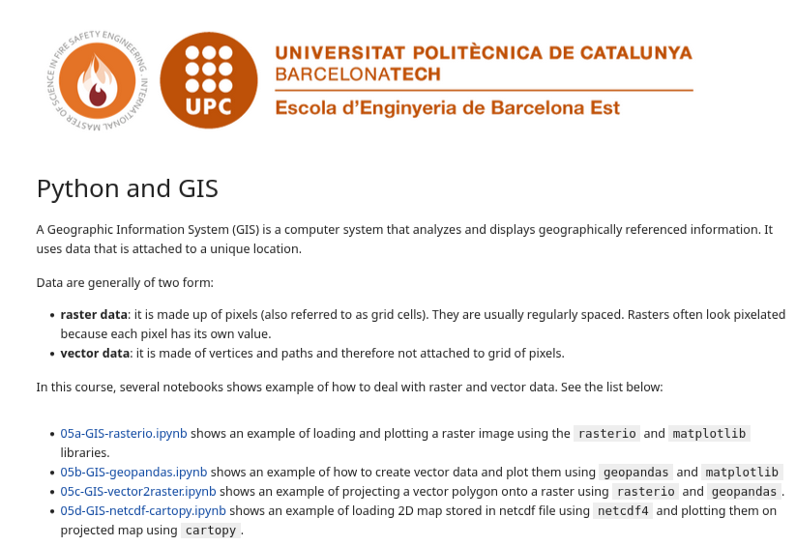
Practical
Here you have a series of example showing basic example of GIS task in pyhton

